Slide 1
Functions (Cont.)
Course Code: CSC 1204
Course Title: Discrete Mathematics
Dept. of Computer Science
Faculty of Science and Technology
Lecturer No: | 6 | Week No: | 3 | Semester:
Lecturer: | Name & email

Slide 2
Lecture Outline
2.3 Functions (Cont.)
Inverse Functions
Compositions of Functions
    Floor function
    Ceiling Function

Slide 3
Objectives and Outcomes
Objectives: To understand Inverse Function, Compositions of Functions, Floor function, and Ceiling Function.
Outcomes: Students are expected to be able to determine whether a function is invertible, be able find out the inverse of a function if the function is invertible, be able to find the composite functions of two given functions, be able to apply floor and ceiling functions.

Slide 4
Inverse Functions
Definition 9: Let f be a one-to-one correspondence (Bijective) from A to B. The inverse function of f is the function that assigns the unique element a (in A) to an element b (belonging to B) such that f(a) = b. Hence,
  f⁻¹(b) = a, when f(a) = b

Slide 5
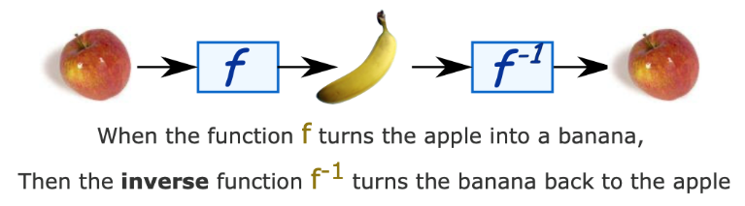
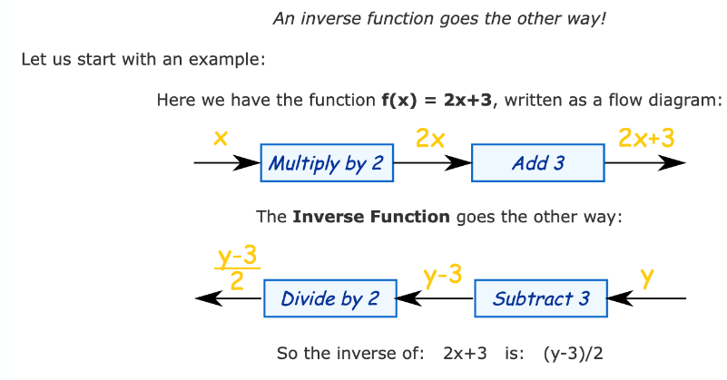
FIGURE: The Function f ^{－1} is the Inverse of Function f

Slide 6
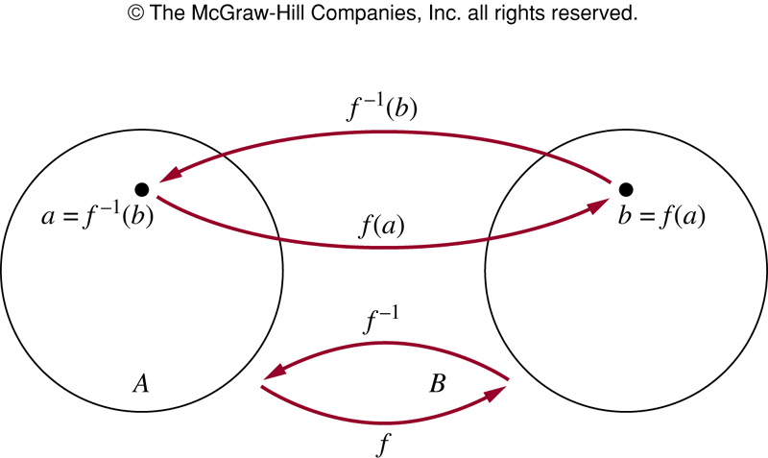
FIGURE: The Function f ^{－1} is the Inverse of Function f

Slide 7
Inverse Functions
A one-to-one correspondence is called invertible because we can define an inverse of this function.
A function is not invertible if it is not a one-to-one correspondence, because the inverse of such a function does not exist.

Slide 8
Example 16
Let f be the function from {a, b, c} to {1, 2, 3} such that f(a) = 2, f(b) = 3, and f(c) = 1.
Is f invertible, and if it is, what is its inverse?
Solution: The function f is invertible because it is a one-to-one correspondence.
The inverse function f ⁻¹ reverses the correspondence given by f. So f ⁻¹(1) = c, f ⁻¹(2) = a, and f ⁻¹(3) = b

Slide 9
Example 17
Let f: Z→Z be such that f(x) = x +1.
Is f invertible? and if it is, what is its inverse?
Solution:
The function f is one-to-one because every element of domain has a distinct image, just 1 bigger than that element.
Again, the function f is onto because every element of codomain has a preimage, just 1 smaller than that element.
Therefore, the function f is a one-to-one correspondence. So, the function f is invertible.
To reverse the correspondence, suppose that y is the image of x, so that y = x+1. Then x = y – 1. This means that y – 1 is the unique element of Z that is sent to y by f. Consequently, f ⁻¹ (y) = y – 1

Slide 10
Example 18
Let f be the function from R to R with f(x) = x².
Is f invertible?
Solution: Because f(-2) = f(2) = 4, f is not one-to-one.
Since f is not one-to-one, it is not one-to-one correspondence. Hence, f is not invertible.

Slide 11
Compositions of Functions
Definition: Let g be a function from the set A to the set B and let f be a function from the set B to the set C.
The composition of functions f and g, denoted by f o g, is defined by (f o g) (a) = f(g(a))
  Note: f o g and g o f are not equal
  Note: The composition f o g can NOT be defined unless the range of g is a subset of the domain of f

Slide 12
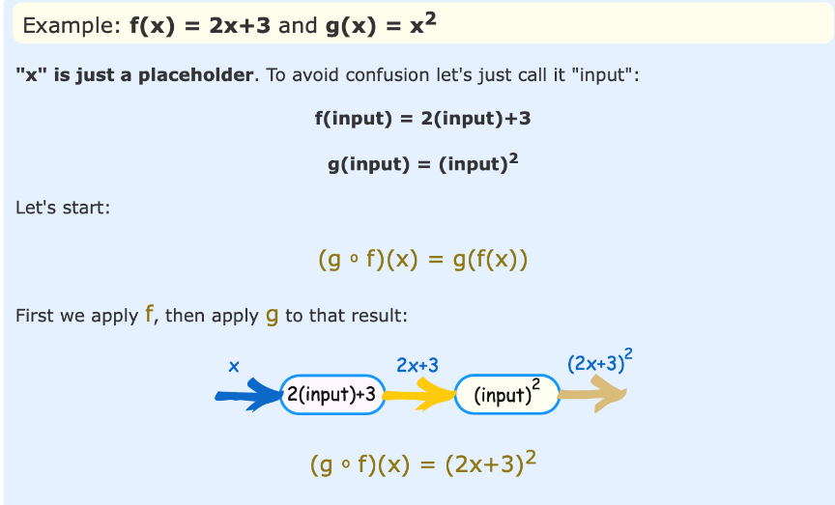

Slide 13
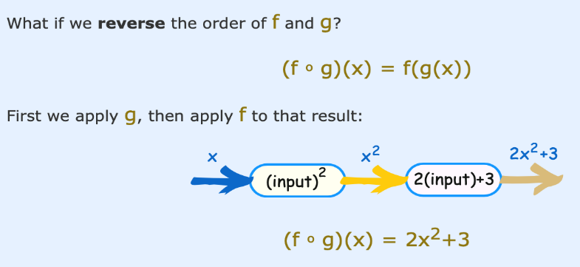

Slide 14
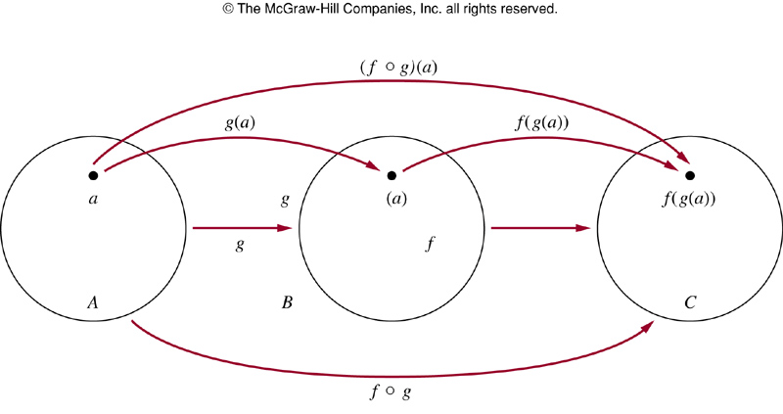
FIGURE : The Composition of the Functions f and g

Slide 15
Modified Example 21
@ p. 141(6th ed.) @ p.149 (7th ed.)
Let f and g be the functions from the set of integers to the set of integers defined by f (x) = 2x + 3 and g (x) = 3x + 2.
Find the composite functions of f and g.
Solution:
The composition of the functions f and g is
(f o g) (x) = f(g(x)) = f (3x+2) = 2(3x+2) + 3 = 6x + 7
The composition of the functions g and f is
(g o f) (x) = g(f(x)) = g(2x+3) = 3(2x+3) + 2 = 6x + 11
Practice @ Home: Example 20 (p.149)

Slide 16
Some Important Functions
Two important functions in discrete mathematics. These functions are often used when objects are counted. They play an important role in the analysis of the number of steps used by procedures to solve problems of a particular size.
      − Floor function
      − Ceiling Function
The floor and ceiling functions map the real numbers
onto the integers (R→Z).

Slide 17
Floor Function
The floor function assigns to the real number x the largest integer that is less than or equal to x.
    − Let x be a real number. The floor function rounds x down to the closest integer less than or equal to x.
The value of the floor function at x is denoted by ⎣ x ⎦
Examples: ⎣2.3⎦ = 2, ⎣2⎦ = 2, ⎣0.5⎦ = 0, ⎣−3.5⎦ = − 4

Slide 18
Ceiling Function
The ceiling function assigns to the real number x the
smallest integer that is greater than or equal to x.
The value of the ceiling function at x is denoted by ⎡x⎤
Examples: ⎡2.3⎤ = 3, ⎡2⎤ = 2, ⎡0.5⎤ = 1, ⎡−3.5⎤ = −3

Slide 19
Examples of Ceiling Function
How many bytes are required to encode 600 kilobits of data? [Note: Each byte is made up of 8 bits]
Answer: ⎡(600X1000)/8⎤ = 75000 bytes
How many bytes are required to encode 1001 bits of data?
Answer: ⎡1001/8 ⎤ = 126 bytes

Slide 20
Example of Floor Function
In asynchronous transfer mode (ATM), data are organized into cells of 53 bytes. How many ATM cells can be transmitted in 1 minute over a connection that transmits data at the rate of 500 kilobits per second?
Solution: In 1 minute this connection can transmit 500x1000x60 bits = 30,000,000 bits
Each ATM cell is 53 bytes long, which means that it is
53x8 = 424 bits long
Number of ATM cells that can be transmitted is
= ⎣ 30,000,000/424 ⎦ = 70,754

Slide 21
Practice @ Home
Relevant odd-numbered exercises from text book

Slide 22
Books
Discrete Mathematics and its applications with combinatorics and graph theory (7th edition) by Kenneth H. Rosen [Indian Adaptation by KAMALA KRITHIVASAN], published by McGraw-Hill

Slide 23
References
Discrete Mathematics, Richard Johnsonbaugh, Pearson education, Inc.
Discrete Mathematical Structures, Bernard Kolman, Robert C. Busby, Sharon Ross, Prentice-Hall, Inc.
SCHAUM’S outlines Discrete Mathematics(2nd edition), by Seymour Lipschutz, Marc Lipson

